Slide 1

DESIGN AND ANALYSIS OF ALGORITHMS (113939)
Dr. Owais Hussain

Slide 2

Agenda
Algorithm Design Strategies
Brute Force
Real Life Examples
Password Cracking
Parallelization
String Matching
Analysis of String-Matching Algorithm

Slide 3
Sample 2
Algorithm Design Strategies
Brute force: starting point, most expensive, useful in benchmarking and proof of concept. Sometimes, the only way to find optimal solution.
Greedy: look for current best solution, relatively less expensive, useful from small-medium scale. Does not guarantee optimal solution.
Divide and Conquer: splits into sub-problems, highly efficient, high memory demands, useful on large scale. Does not work on problems that are recursive in nature.
Backtracking: ability to go back to previous stage, expensive, used to solve strategic problems. Does not guarantee optimal solution but finds all valid solutions.
Dynamic programming: solves a subproblem only once and reuses previous solutions. Guarantees optimal solution iff the problem has optimal structure.
Notes:
A problem has optimal structure if it can be broken into smaller subproblems and the optimal solution to subproblems guarantees optimal solution to original problem.

Slide 4
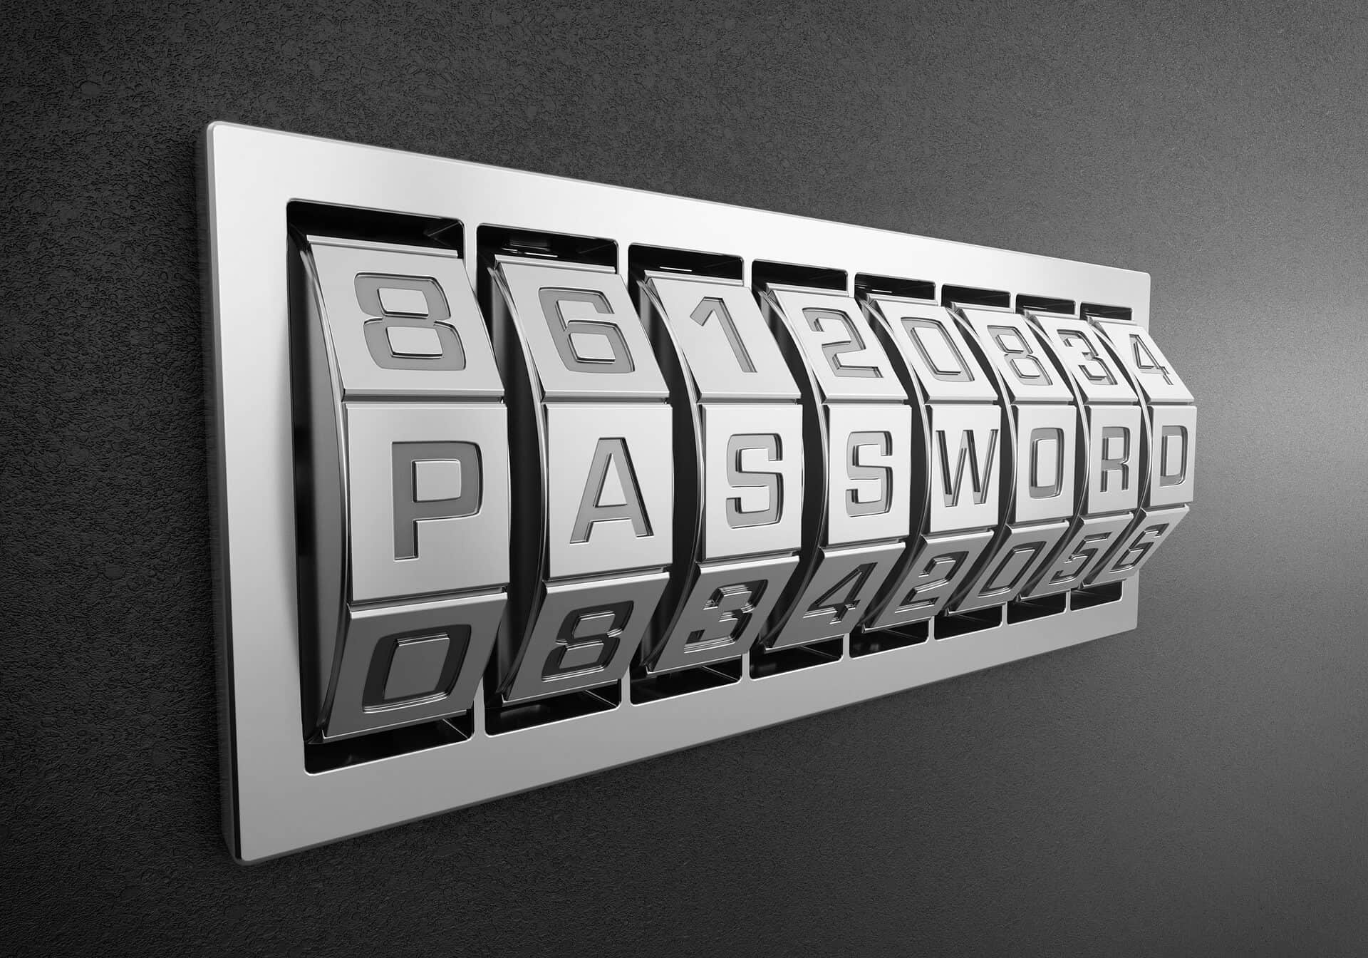
Sample 2
Brute Force
Brute force approach throws everything in the kitchen sink at the problem.
Exhaustively try all possible combinations until the solution is met.
Brute force Guarantees optimal solution, if a solution exists.
Uses: on small-scale/unit subproblem; testing and benchmarking; straightforward to design/apply/explain.
Unfortunately, Brute Force is often the slowest approach. This is why it should be avoided whenever possible.

Slide 5
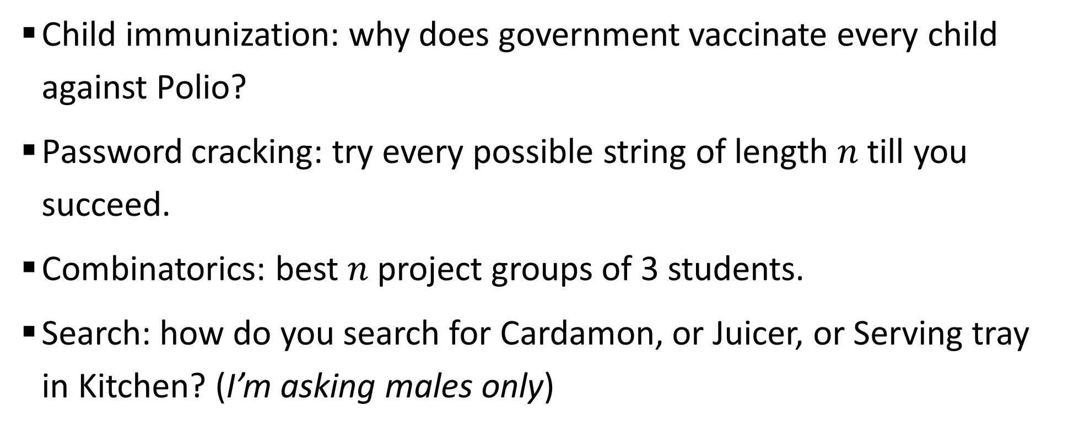
Sample 2
Real Life Examples
Child immunization: why does government vaccinate every child against Polio?
Password cracking: try every possible string of length $n$ till you succeed.
Combinatorics: best $n$ project groups of 3 students.
Search: how do you search for Cardamon, or Juicer, or Serving tray in Kitchen? (I’m asking males only)
Notes:
Best project group could be determined by: living close/F&F, picking same courses, diverse skillset, mixed grades, etc.

Slide 6
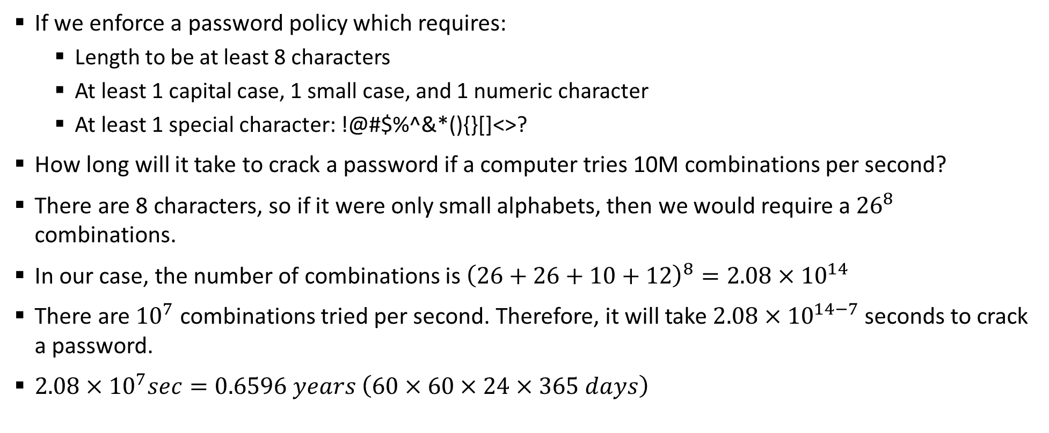
Sample 2
Password Cracking
If we enforce a password policy which requires:
Length to be at least 8 characters
At least 1 capital case, 1 small case, and 1 numeric character
At least 1 special character: !@#$%^&*(){}[]<>?
How long will it take to crack a password if a computer tries 10M combinations per second?
There are 8 characters, so if it were only small alphabets, then we would require a ${26}^{8}$ combinations.
In our case, the number of combinations is ${\left(26+26+10+12\right)}^{8}=2.08×{10}^{14}$
There are ${10}^{7}$ combinations tried per second. Therefore, it will take $2.08×{10}^{14−7}$ seconds to crack a password.
$2.08×{10}^{7}sec=0.6596 years \left(60×60×24×365 days\right)$

Slide 7
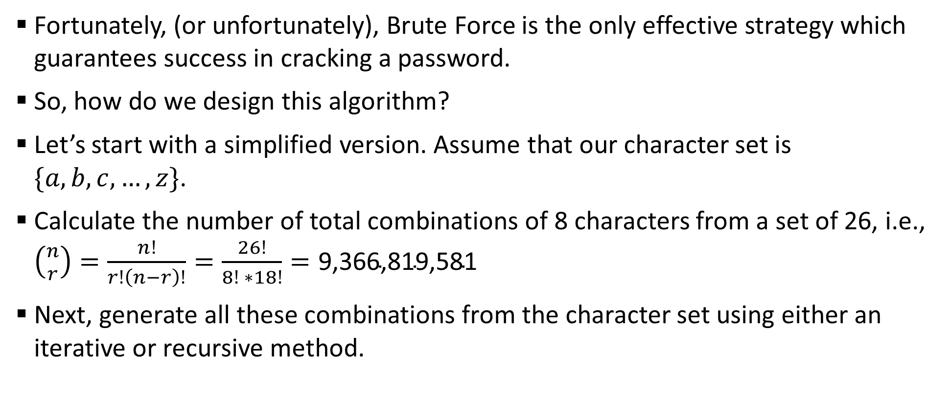
Sample 2
Password Cracking
Fortunately, (or unfortunately), Brute Force is the only effective strategy which guarantees success in cracking a password.
So, how do we design this algorithm?
Let’s start with a simplified version. Assume that our character set is $\{a, b, c, …, z\}$.
Calculate the number of total combinations of 8 characters from a set of 26, i.e., $\left({n \atop r}\right)=\frac{n!}{r!\left(n−r\right)!}=\frac{26!}{8! ∗18!}=\text{9,366,819,581}$
Next, generate all these combinations from the character set using either an iterative or recursive method.

Slide 8
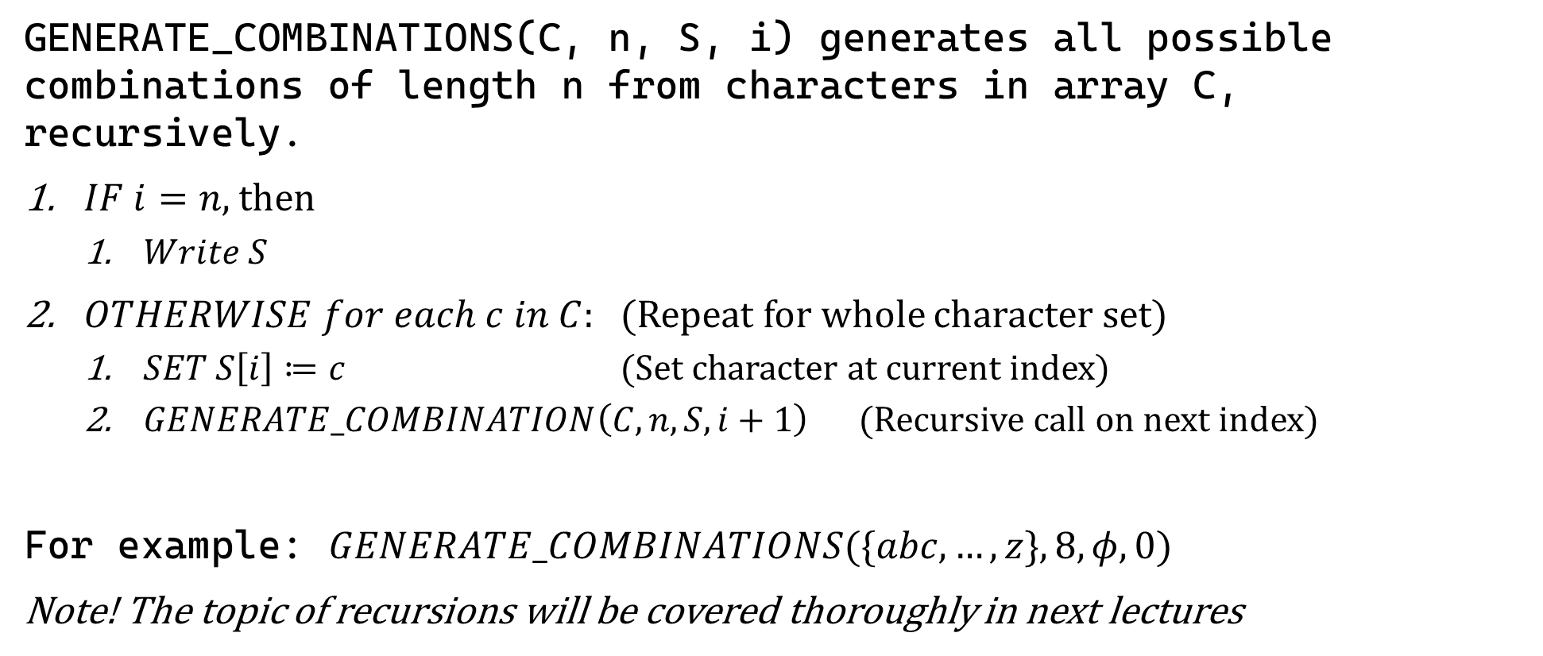
Sample 2
Password Cracking
GENERATE_COMBINATIONS(C, n, S, i) generates all possible combinations of length n from characters in array C, recursively.
$IF i=n$, then
$Write S$
$OTHERWISE for each c in C:$ (Repeat for whole character set)
$SET S\left[i\right]≔c$ (Set character at current index)
$GENERATE_COMBINATION\left(C, n, S, i+1\right)$ (Recursive call on next index)
For example: $GENERATE_COMBINATIONS(\{abc,…,z\}, 8,φ, 0)$
Note! The topic of recursions will be covered thoroughly in next lectures
Notes:
Demonstrate code

Slide 9
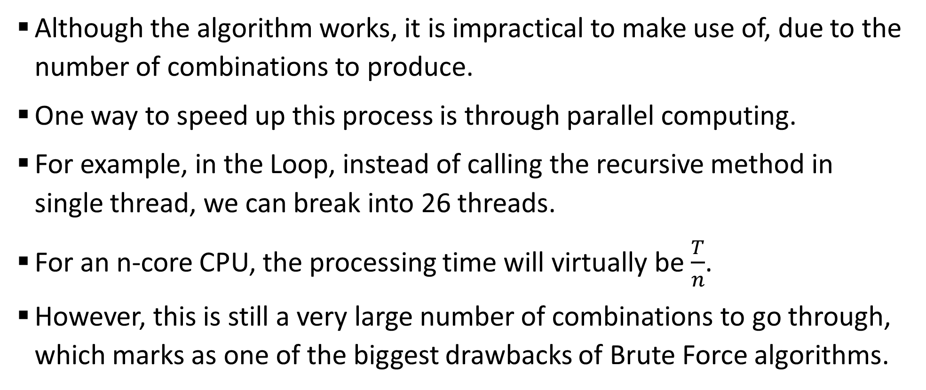
Sample 2
Parallelization
Although the algorithm works, it is impractical to make use of, due to the number of combinations to produce.
One way to speed up this process is through parallel computing.
For example, in the Loop, instead of calling the recursive method in single thread, we can break into 26 threads.
For an n-core CPU, the processing time will virtually be $\frac{T}{n}$.
However, this is still a very large number of combinations to go through, which marks as one of the biggest drawbacks of Brute Force algorithms.

Slide 10
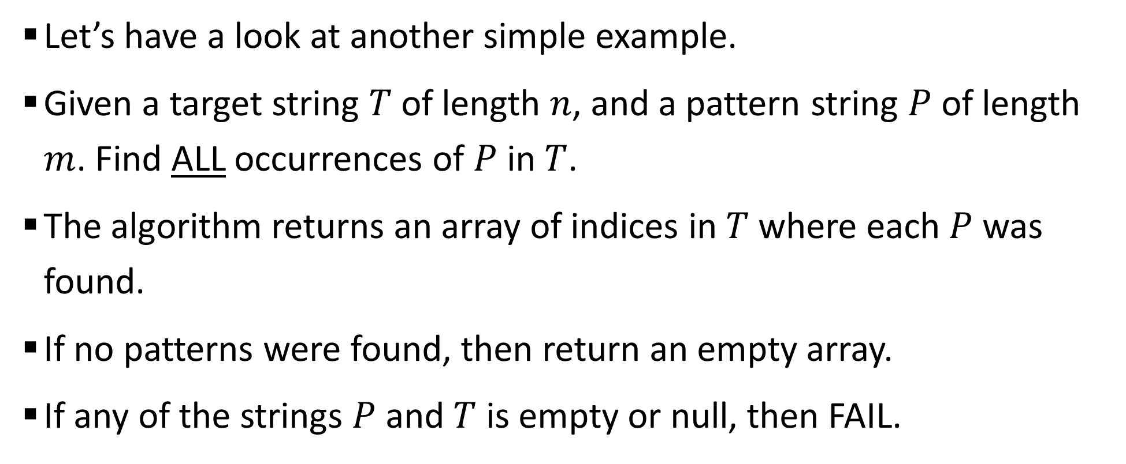
Sample 2
String Matching
Let’s have a look at another simple example.
Given a target string $T$ of length $n$, and a pattern string $P$ of length $m$. Find ALL occurrences of $P$ in $T$.
The algorithm returns an array of indices in $T$ where each $P$ was found.
If no patterns were found, then return an empty array.
If any of the strings $P$ and $T$ is empty or null, then FAIL.

Slide 11
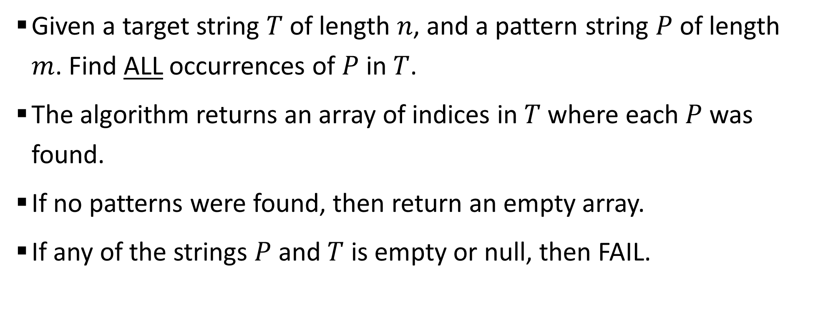
Sample 2
String Matching
Given a target string $T$ of length $n$, and a pattern string $P$ of length $m$. Find ALL occurrences of $P$ in $T$.
The algorithm returns an array of indices in $T$ where each $P$ was found.
If no patterns were found, then return an empty array.
If any of the strings $P$ and $T$ is empty or null, then FAIL.

Slide 12
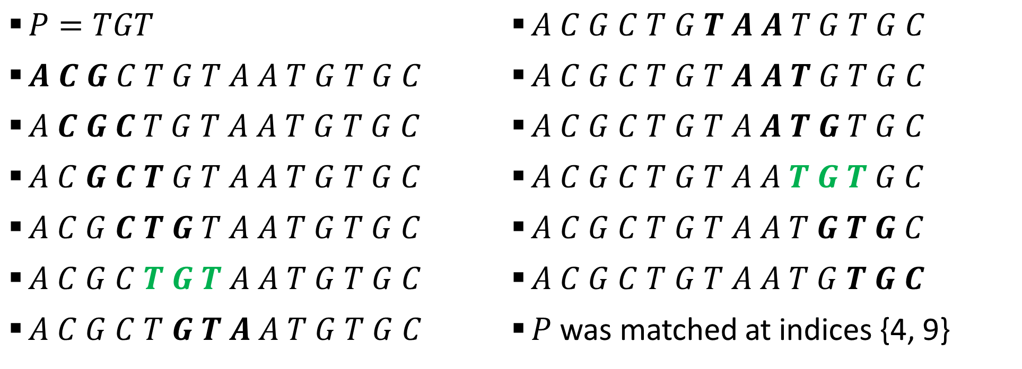
Sample 2
String Matching
0 | 1 | 2 | 3 | 4 | 5 | 6 | 7 | 8 | 9 | 10 | 11 | 12 | 13
A | C | G | C | T | G | T | A | A | T | G | T | G | C
$P=TGT$
$A C G C T G T A A T G T G C$
$A C G C T G T A A T G T G C$
$A C G C T G T A A T G T G C$
$A C G C T G T A A T G T G C$
$A C G C T G T A A T G T G C$
$A C G C T G T A A T G T G C$
$A C G C T G T A A T G T G C$
$A C G C T G T A A T G T G C$
$A C G C T G T A A T G T G C$
$A C G C T G T A A T G T G C$
$A C G C T G T A A T G T G C$
$A C G C T G T A A T G T G C$
$P$ was matched at indices {4, 9}

Slide 13
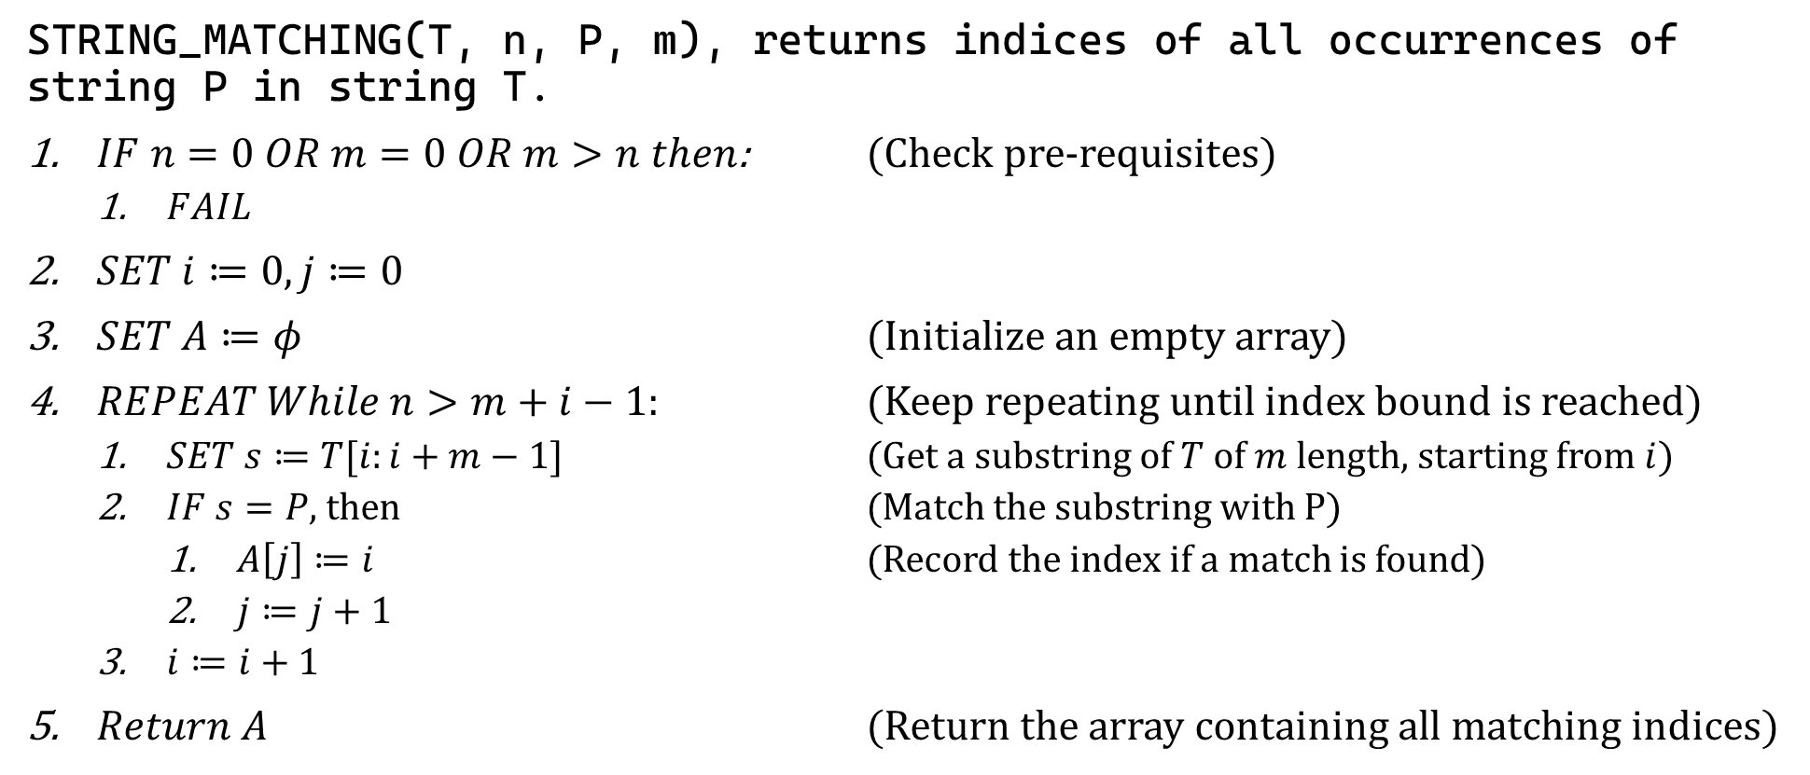
Sample 2
String Matching
STRING_MATCHING(T, n, P, m), returns indices of all occurrences of string P in string T.
$IF n=0 OR m=0 OR m>n then$: (Check pre-requisites)
$FAIL$
$SET i≔0, j≔0$
$SET A≔φ$ (Initialize an empty array)
$REPEAT While n>m+i−1:$ (Keep repeating until index bound is reached)
$SET s≔T[i:i+m−1]$ (Get a substring of $T$ of $m$ length, starting from $i$)
$IF s=P$, then (Match the substring with P)
$A\left[j\right]≔i$ (Record the index if a match is found)
$j≔j+1$
$i≔i+1$
$Return A$ (Return the array containing all matching indices)

Slide 14
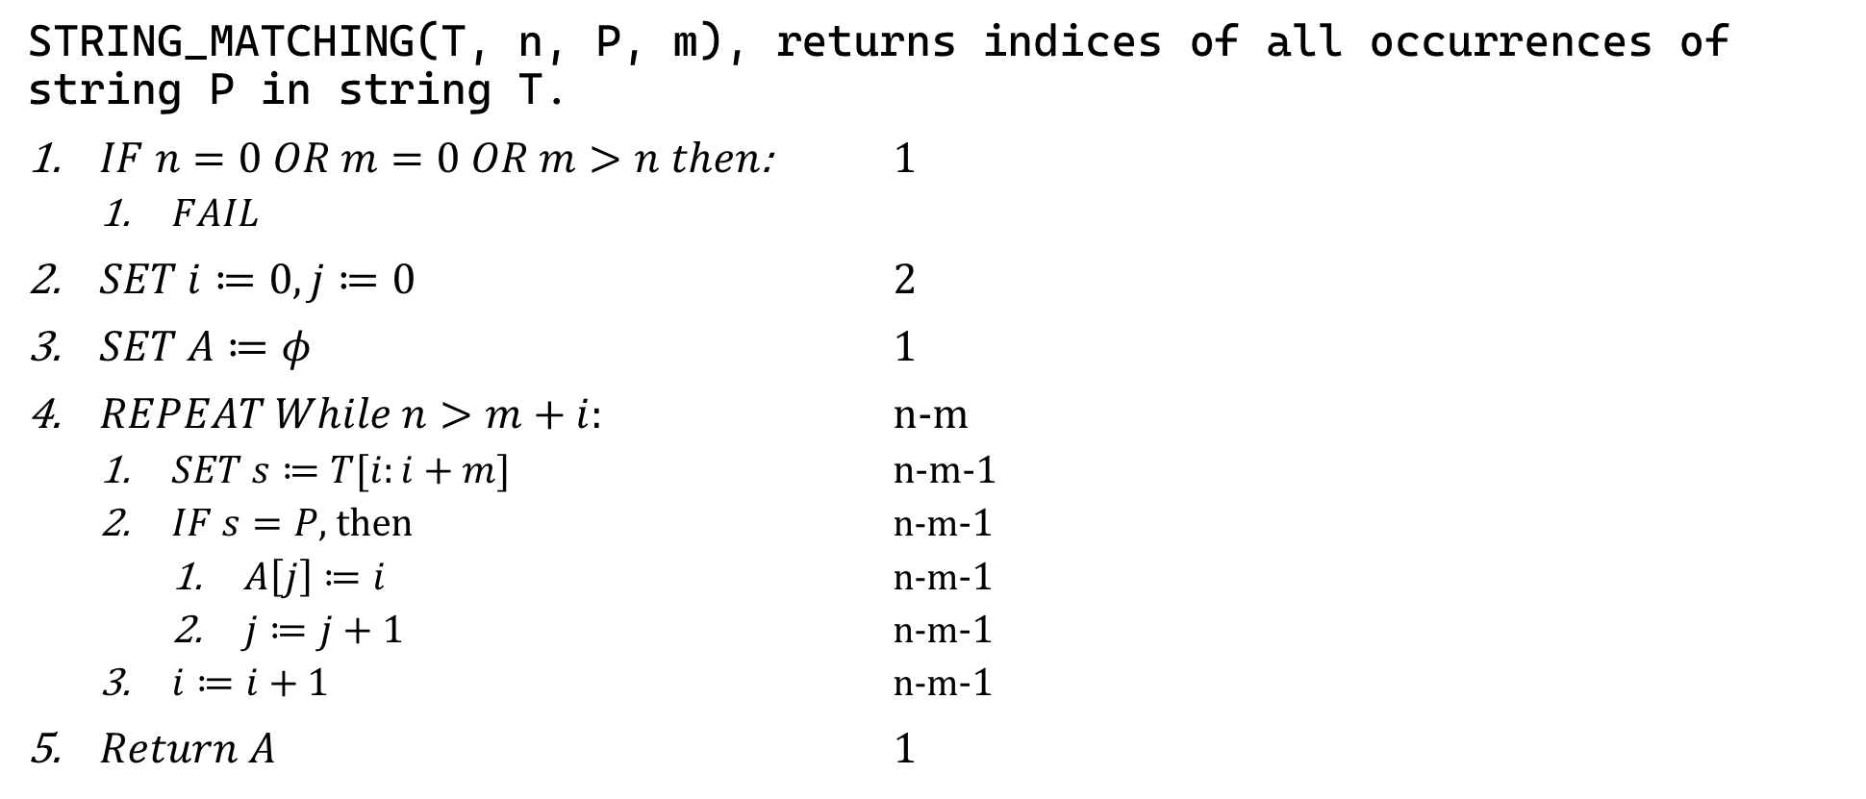
Sample 2
Analysis of String-Matching Algorithm
STRING_MATCHING(T, n, P, m), returns indices of all occurrences of string P in string T.
$IF n=0 OR m=0 OR m>n then$: 1
$FAIL$
$SET i≔0, j≔0$ 2
$SET A≔φ$ 1
$REPEAT While n>m+i:$ n-m
$SET s≔T[i:i+m]$ n-m-1
$IF s=P$, then n-m-1
$A\left[j\right]≔i$ n-m-1
$j≔j+1$ n-m-1
$i≔i+1$ n-m-1
$Return A$ 1

Slide 15
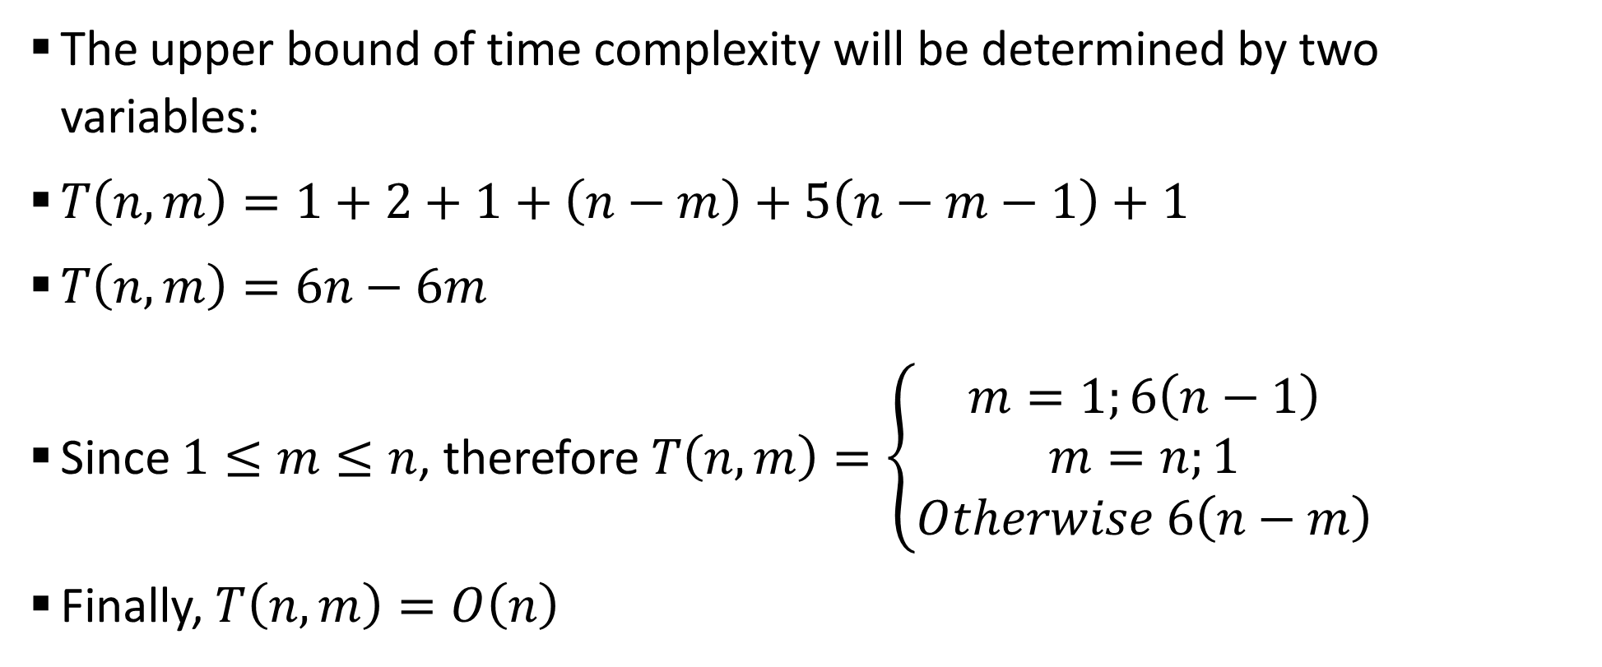
Sample 2
Analysis of String-Matching Algorithm
The upper bound of time complexity will be determined by two variables:
$T\left(n,m\right)=1+2+1+\left(n−m\right)+5\left(n−m−1\right)+1$
$T\left(n,m\right)=6n−6m$
Since $1≤m≤n$, therefore $T\left(n,m\right)=\left\{\begin{aligned}m=1;6\left(n−1\right) \\ m=n;1 \\ Otherwise 6\left(n−m\right)\end{aligned}\right.$
Finally, $T\left(n,m\right)=O\left(n\right)$

Slide 16
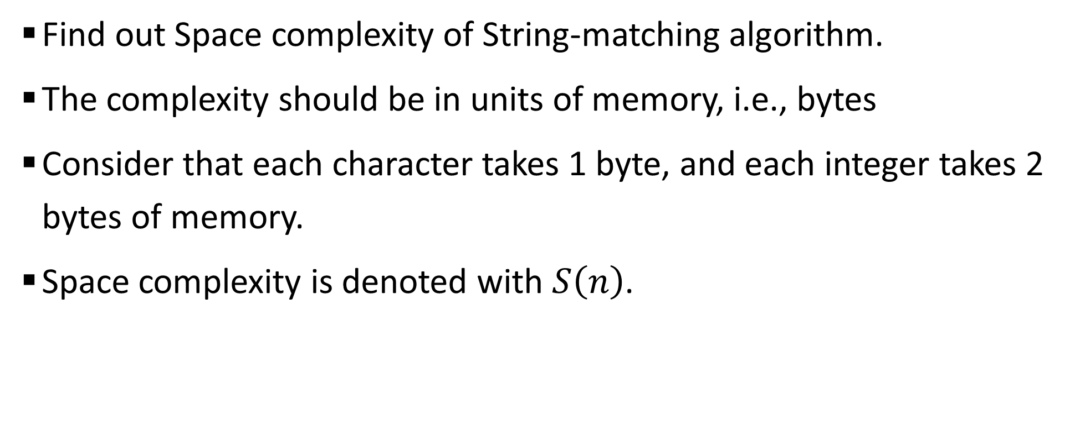
Sample 2
Exercise
Find out Space complexity of String-matching algorithm.
The complexity should be in units of memory, i.e., bytes
Consider that each character takes 1 byte, and each integer takes 2 bytes of memory.
Space complexity is denoted with $S\left(n\right)$.

Slide 17



THANK YOU
Owais Hussain
+92 345-3174270
owais.hussain@kiet.edu.pk
https://www.researchgate.net/profile/Owais-Hussain-3

